Slide 1
Ray-Tracing a Polygon Mesh
2019 01 11

Slide 2
What is a polygon mesh
How is the information about mesh stored

Slide 3
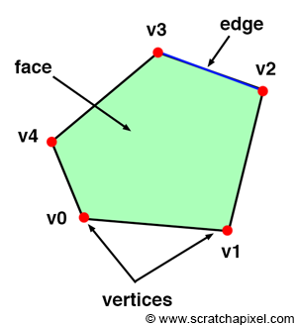
Polygon
CCW(counter clock-wise), CW(clock-wise)
: ordering of the vertices, winding
→ normal vector 방향을 결정한다
Polygon is Planar shape

